Slide 1


Hackers Cheat, So Should You
Ben Denton, PhD.
University of Alabama in Huntsville | DESE Research, Inc.
2018 National Cyber Summit

Slide 2
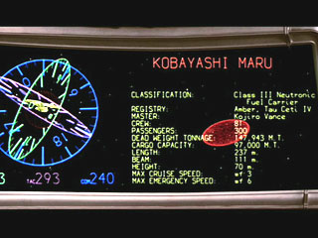
In a galaxy far, far away…
How do we teach hacking when we always force students to follow the rules?
Hackers don’t follow the rules.
This presentation details the results of an impossible assignment given to both a graduate and undergraduate course in cyber security.
Classroom is a computer lab.
The Assignment
You will be required to write out the first 100 digits of the mathematical constant, π. Bring your own paper.

Slide 3

Means of Cheating
In Plain Sight
Hidden Cleartext
Audio Aided
Cipher
Foreign Language
Non-cheating
Lazy A Student

Slide 4
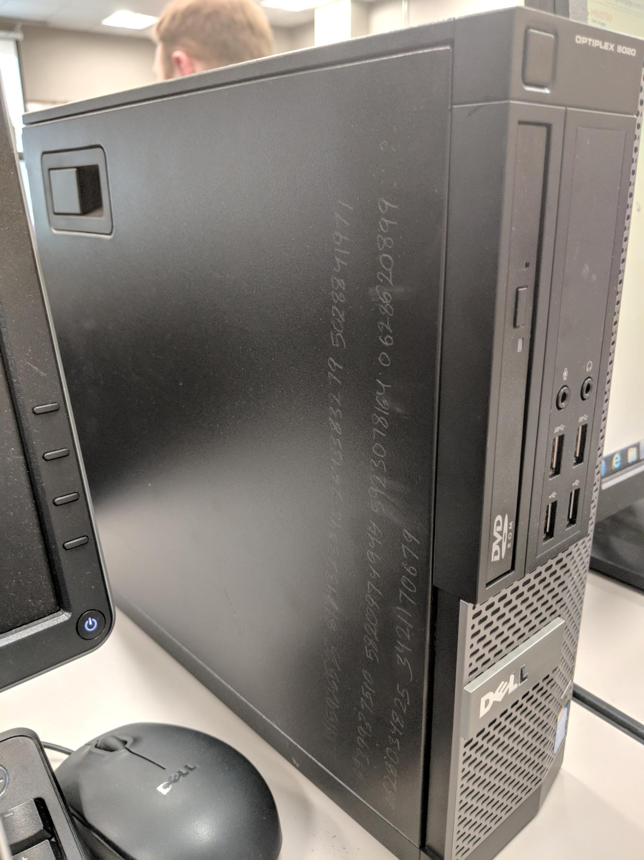
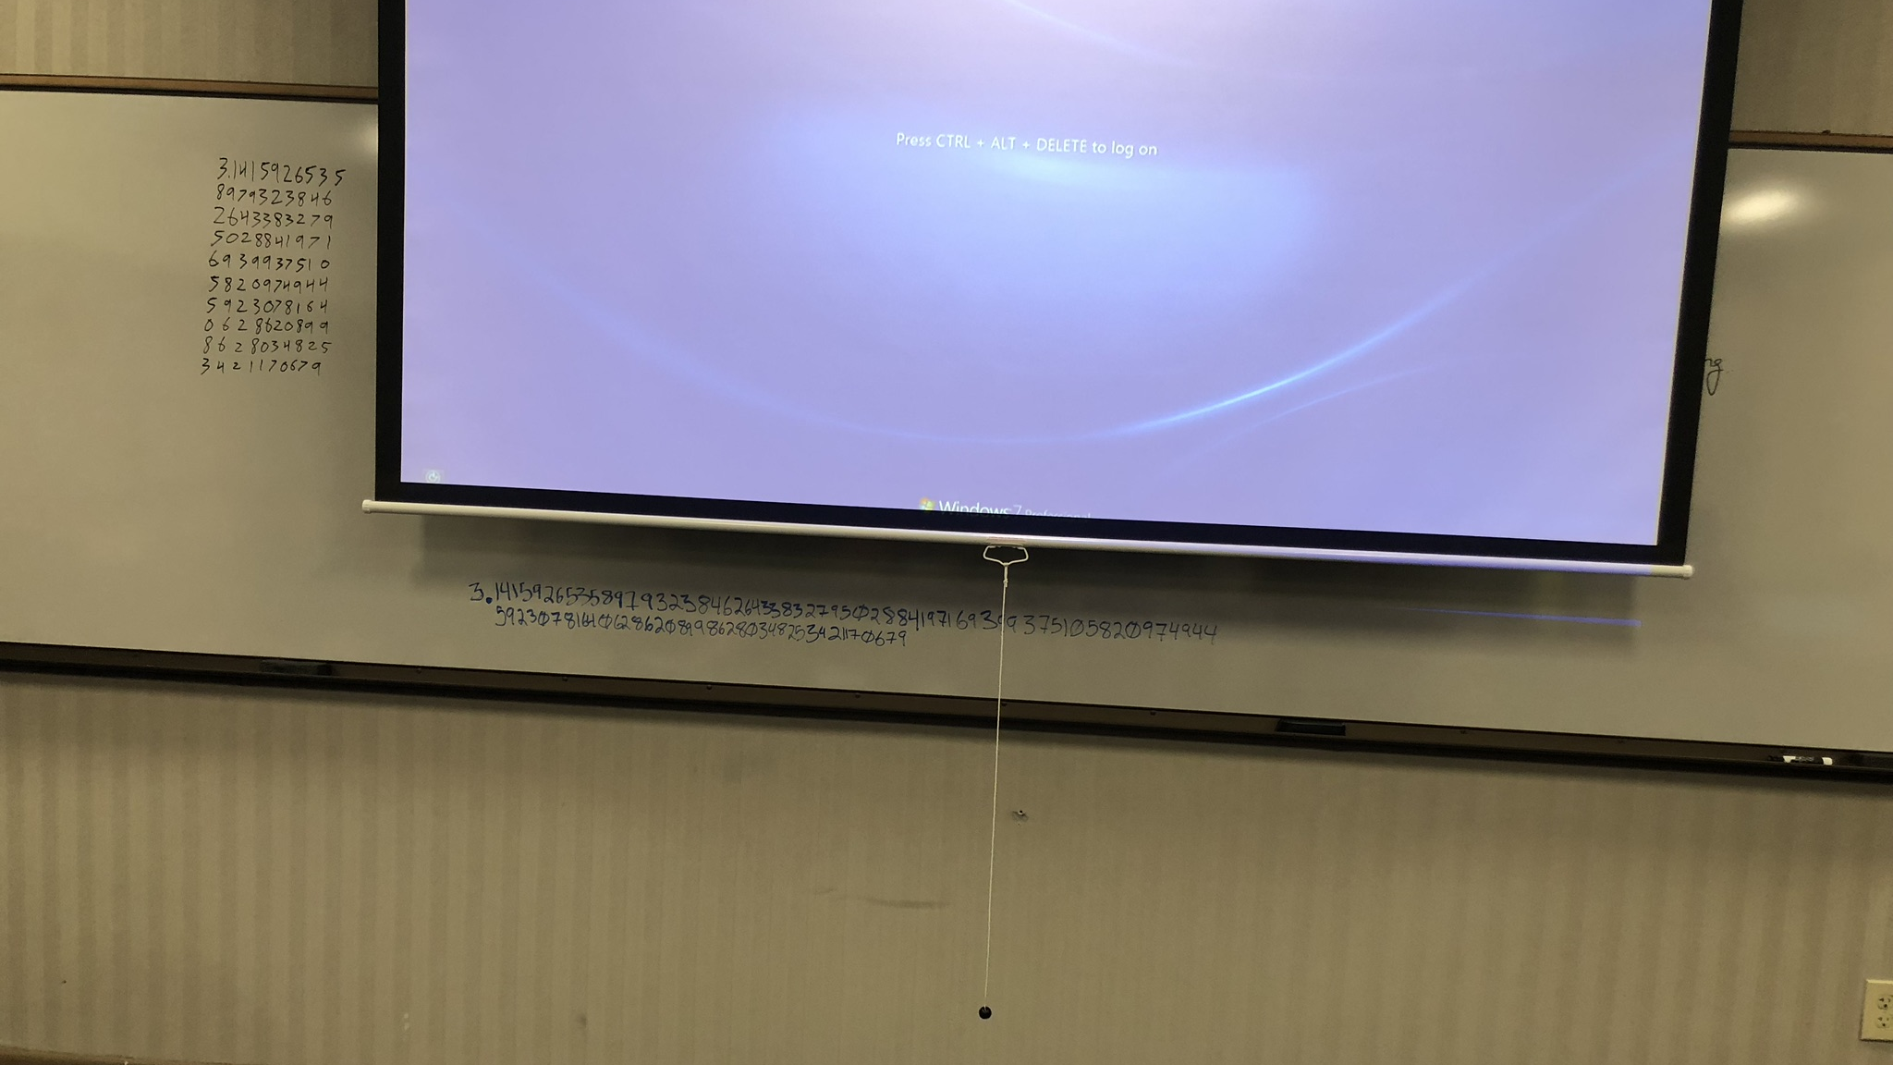
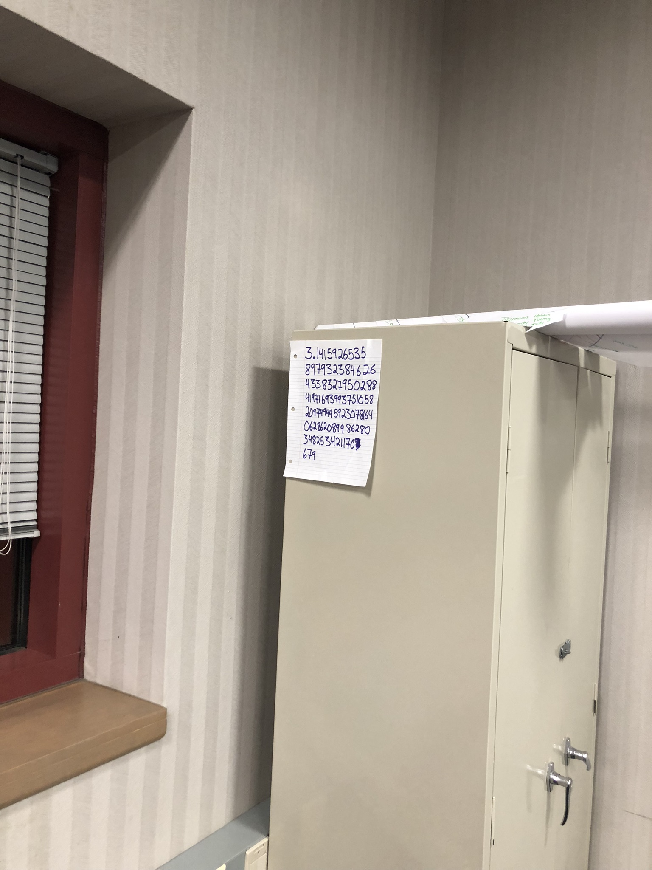
In plain sight
Taped answer to the side of a cabinet
Written on the white board. Attempted to use the projection screen to hide the answers.
Written on side of computer.

Slide 5
Hidden Cleartext
Written on common objects (hidden on person or in class)
Receipt, Scrap Paper, Inside Pen
Textbook cover, Syllabus
Cell phone or smartwatch screen
Under bag of granola, Inside water bottle label
Invisible text
Press firmly on notebook paper, bring in the resulting imprinted result, & trace numbers in class
Invisible ink and black light (How did I miss this one?)
PowerPoint Slide
Use “B” hotkey to hide slide when instructor was near

Slide 6
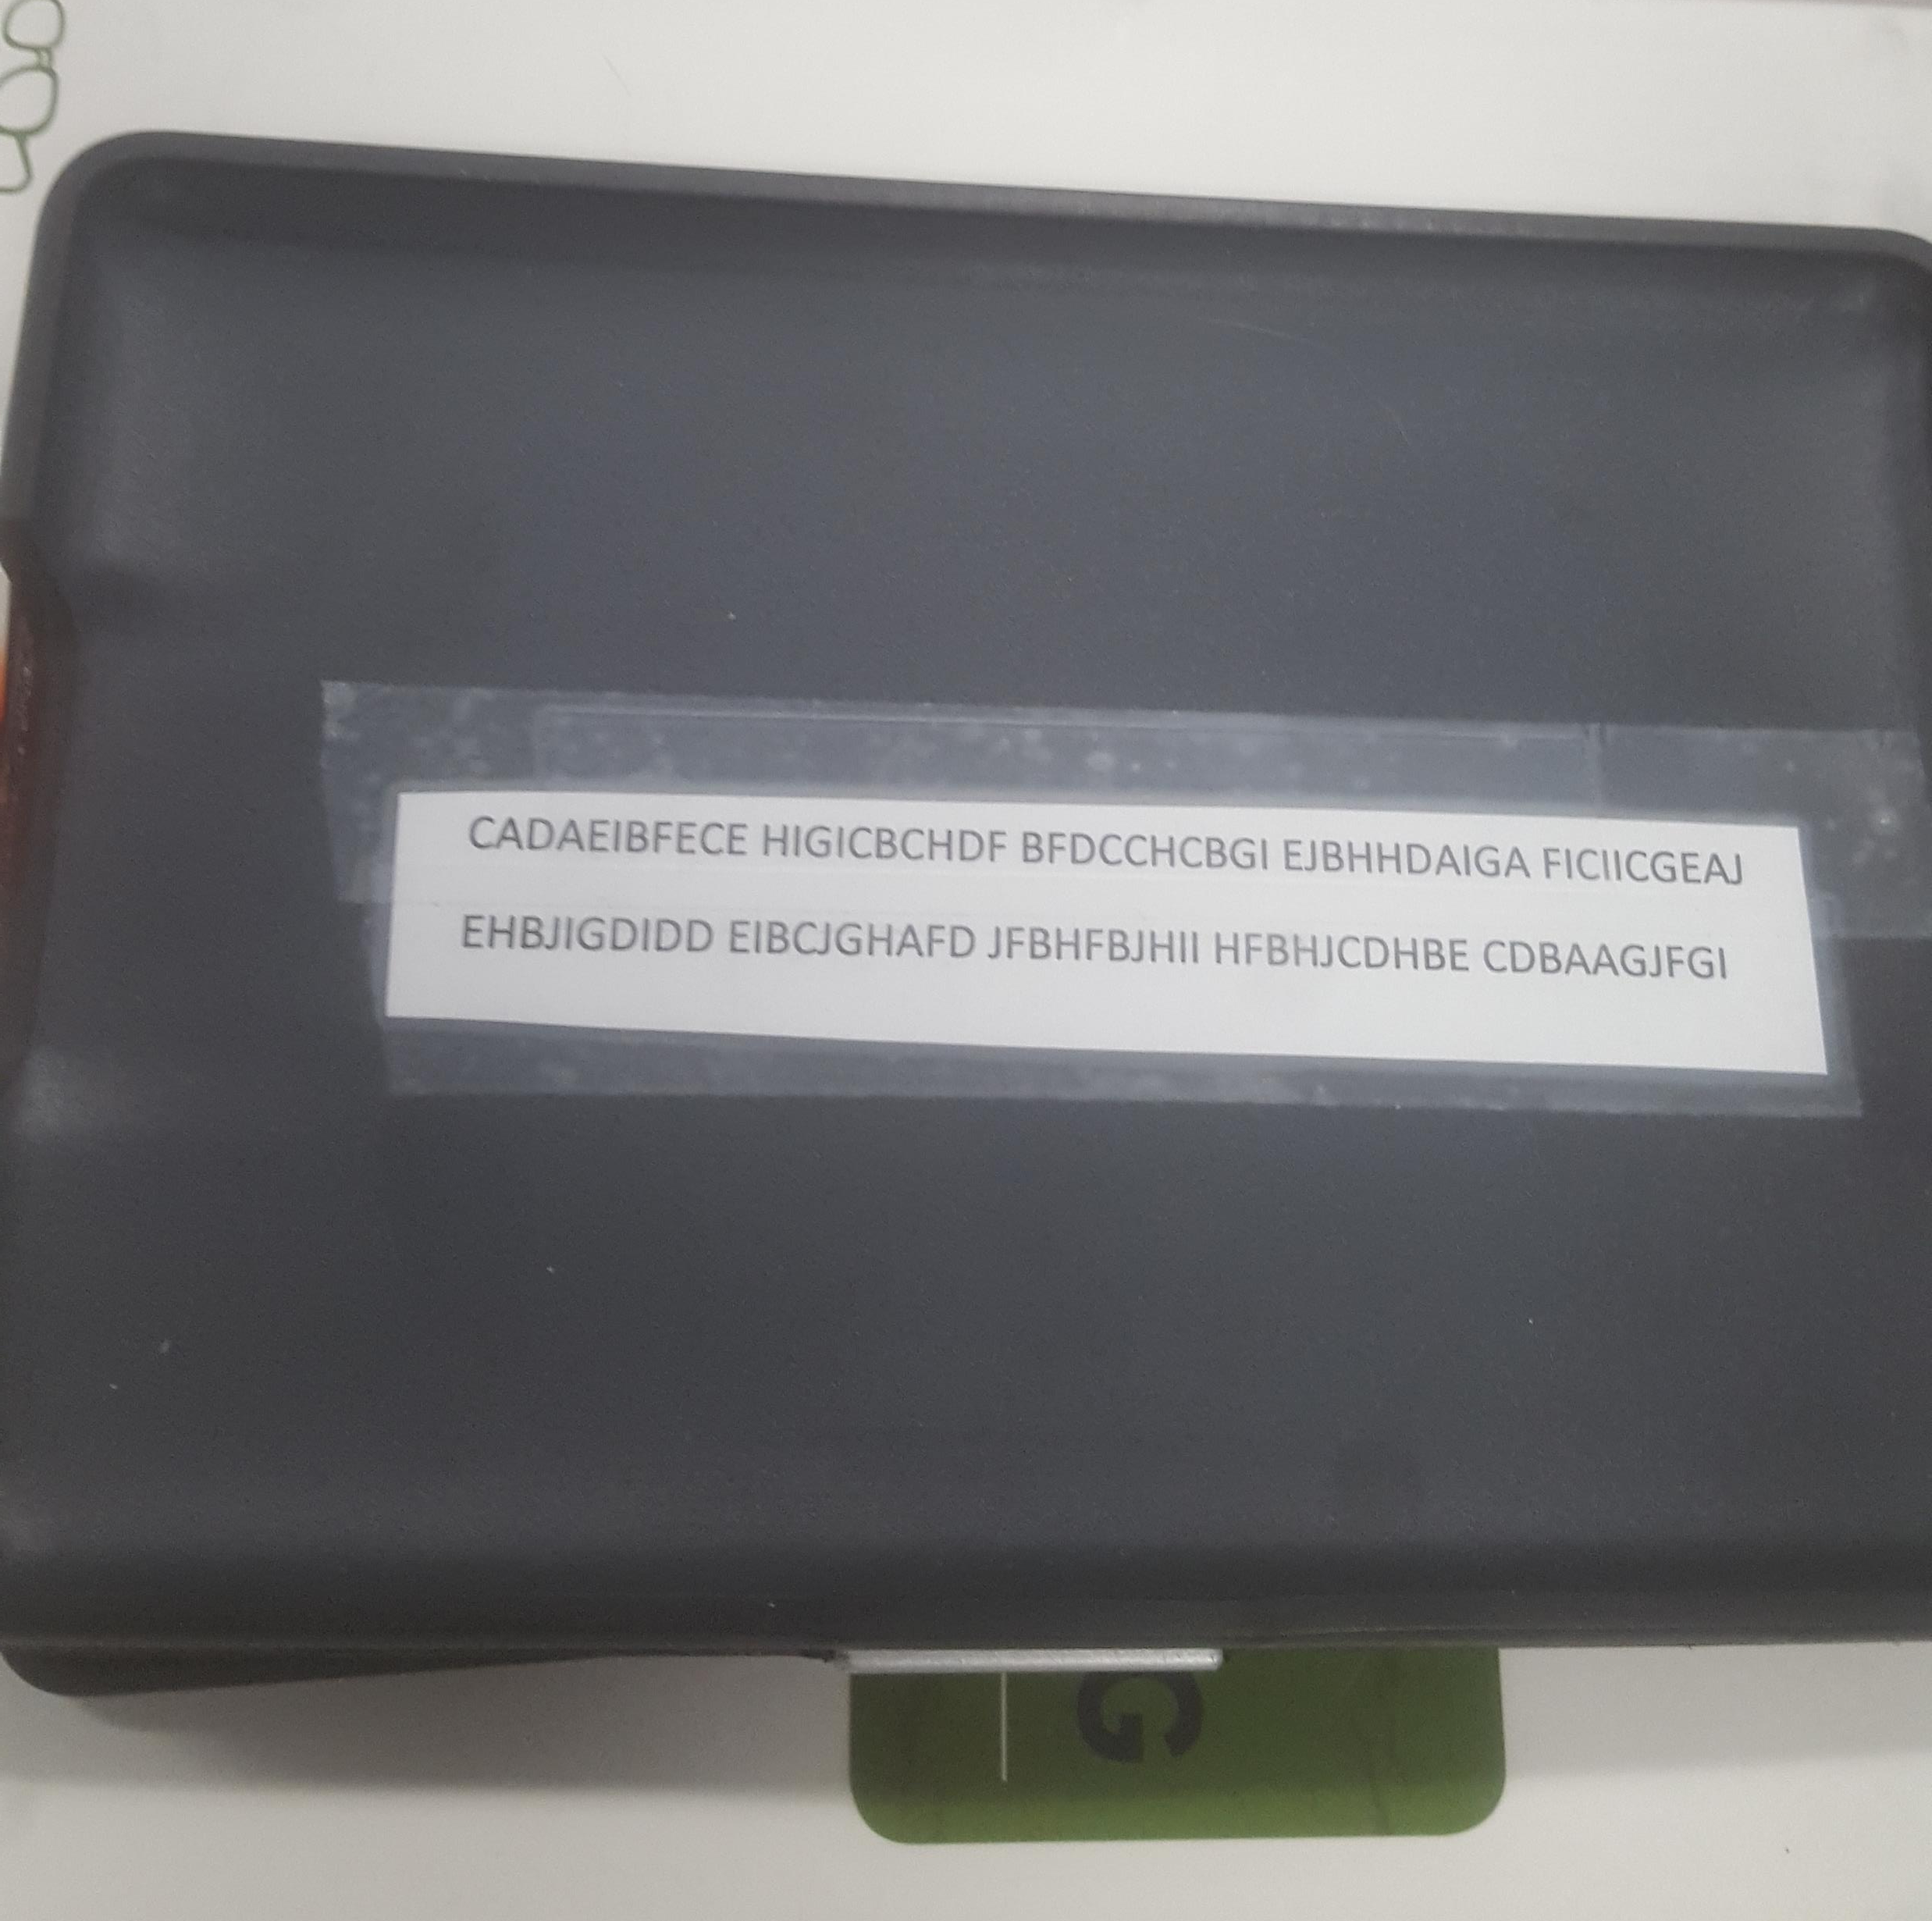
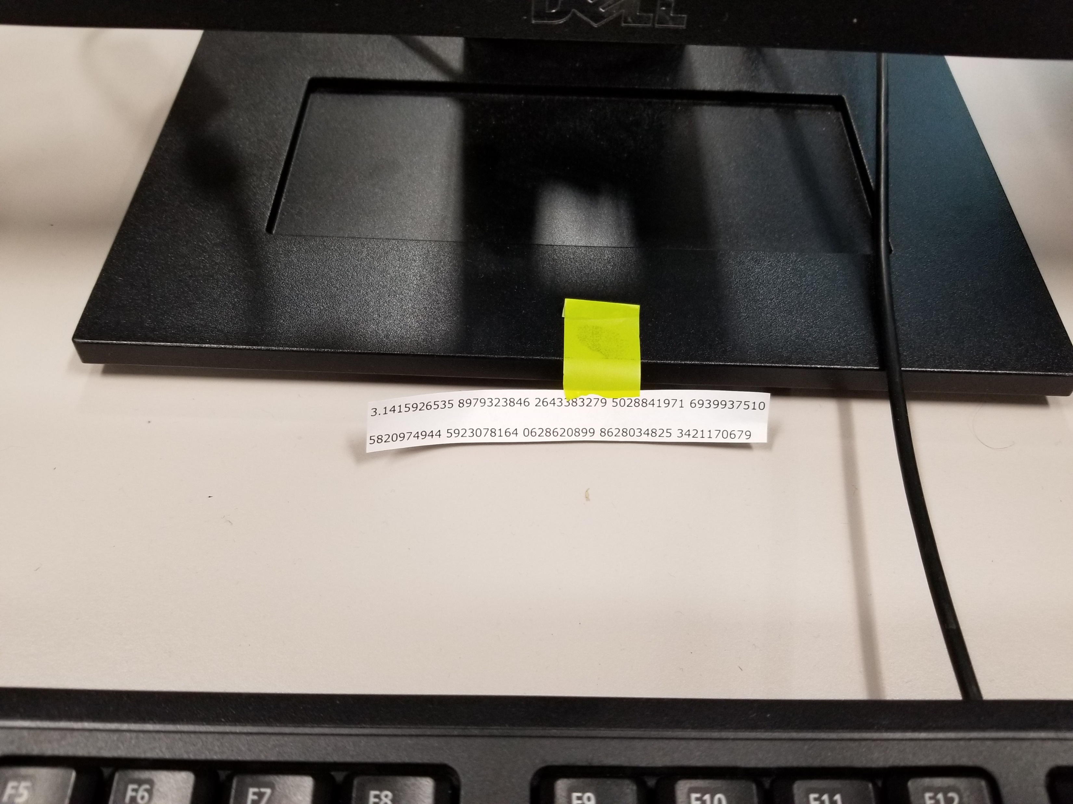
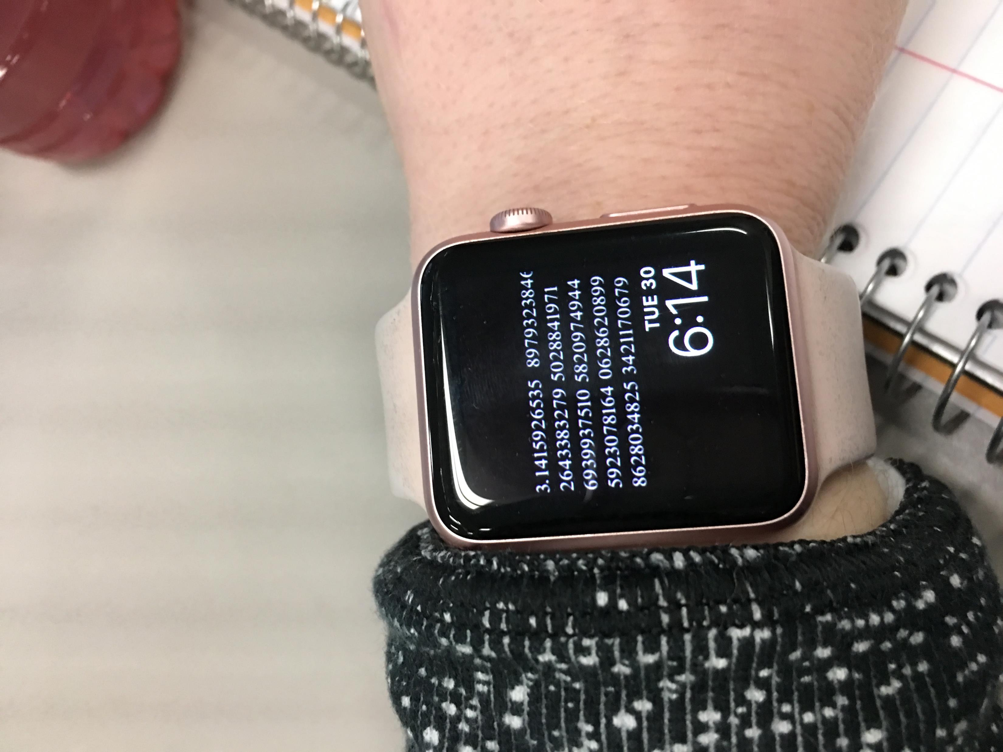
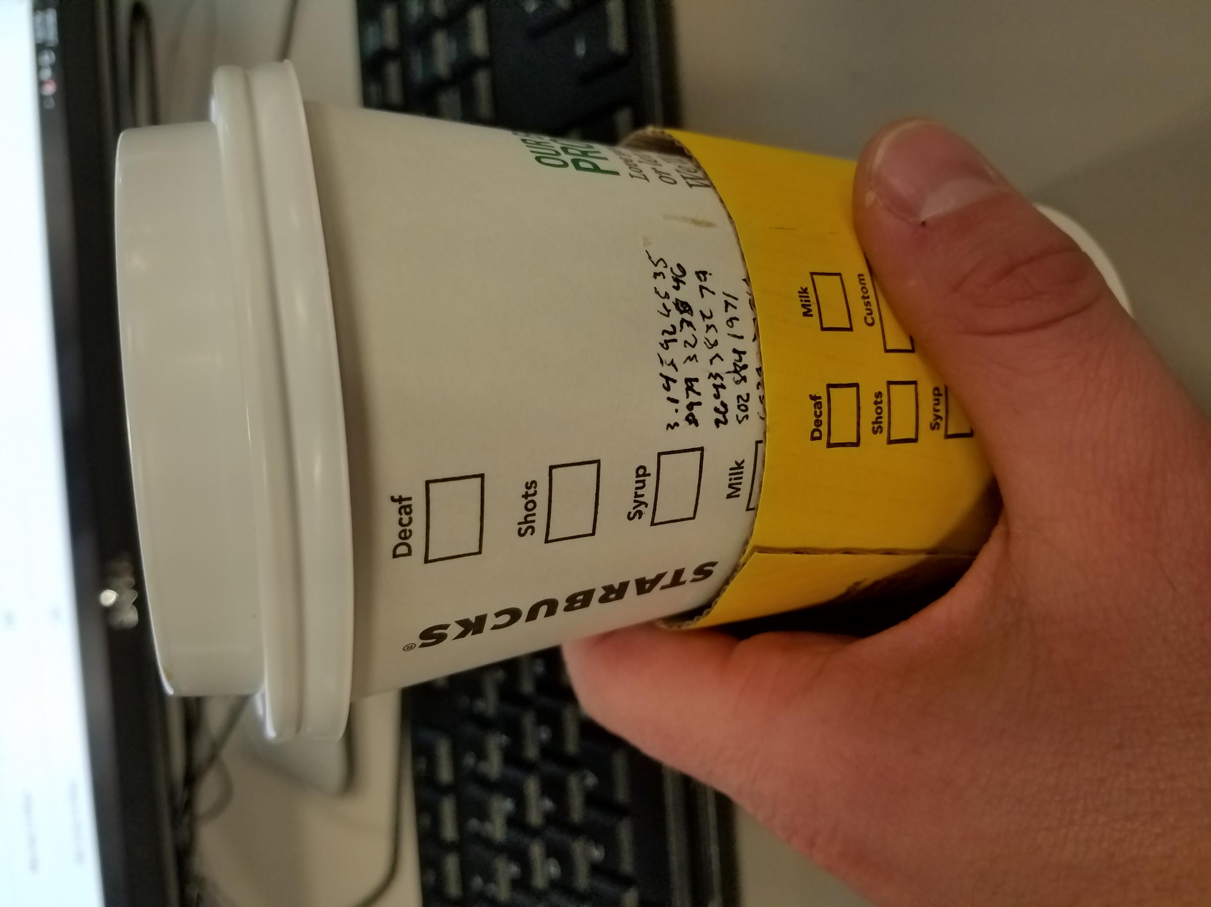

Slide 7
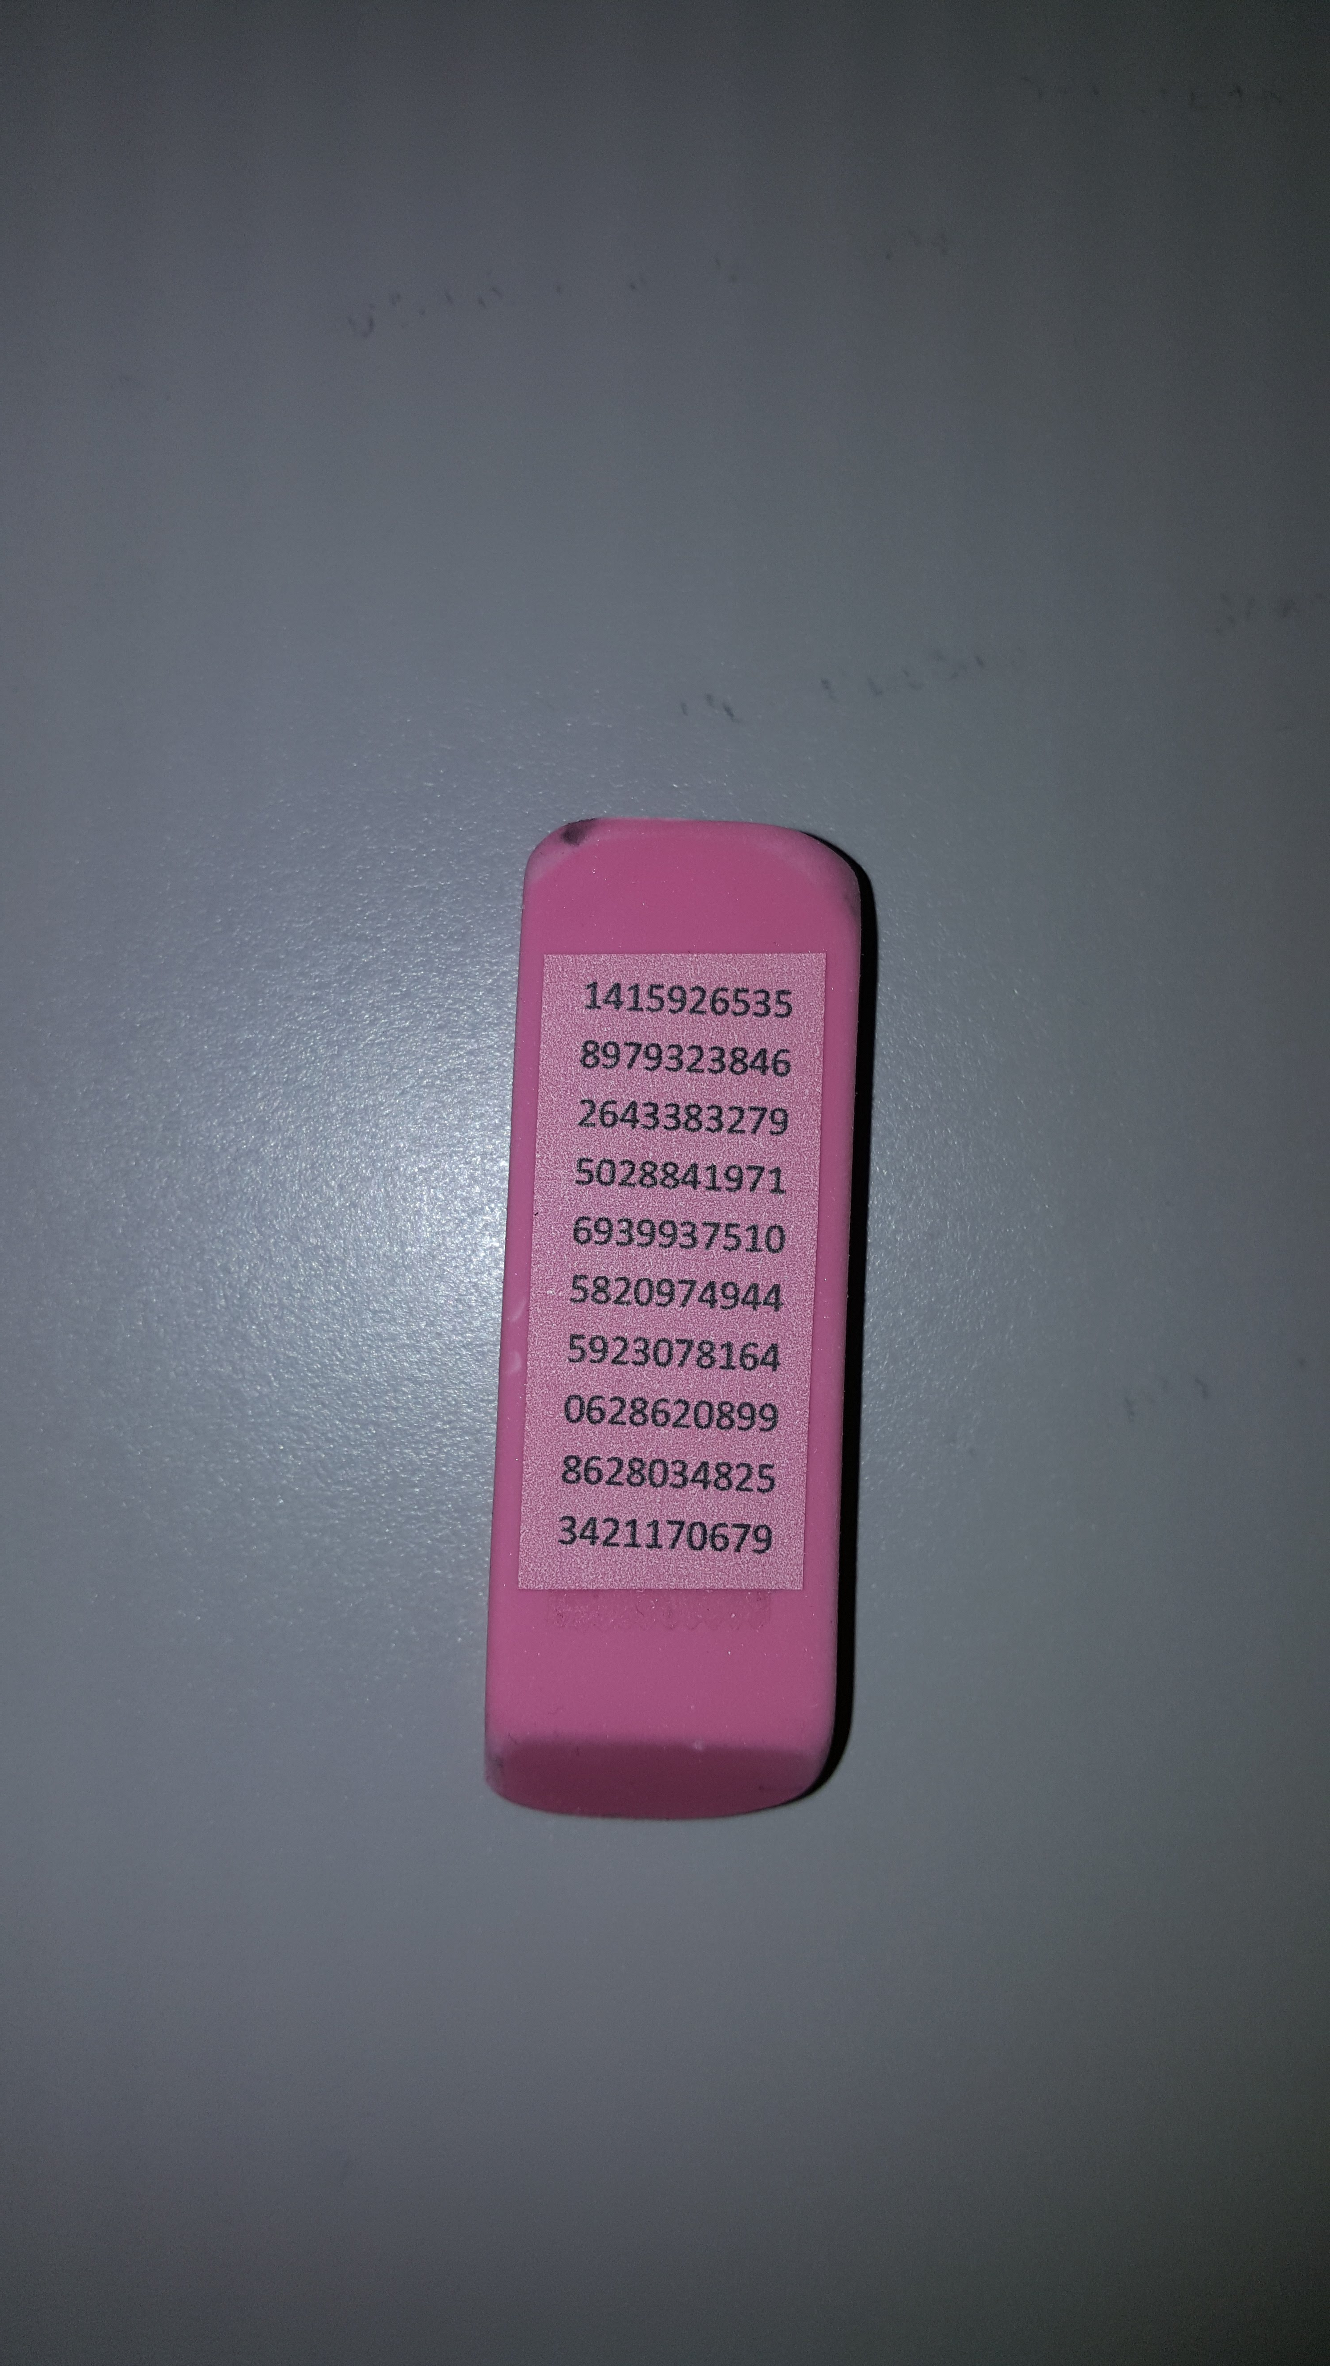
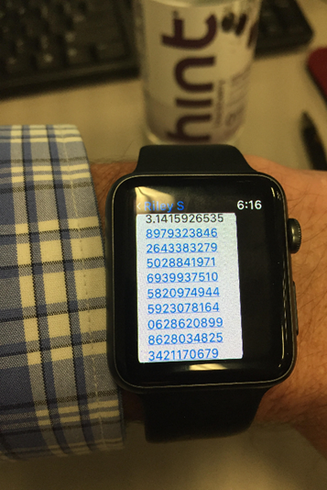
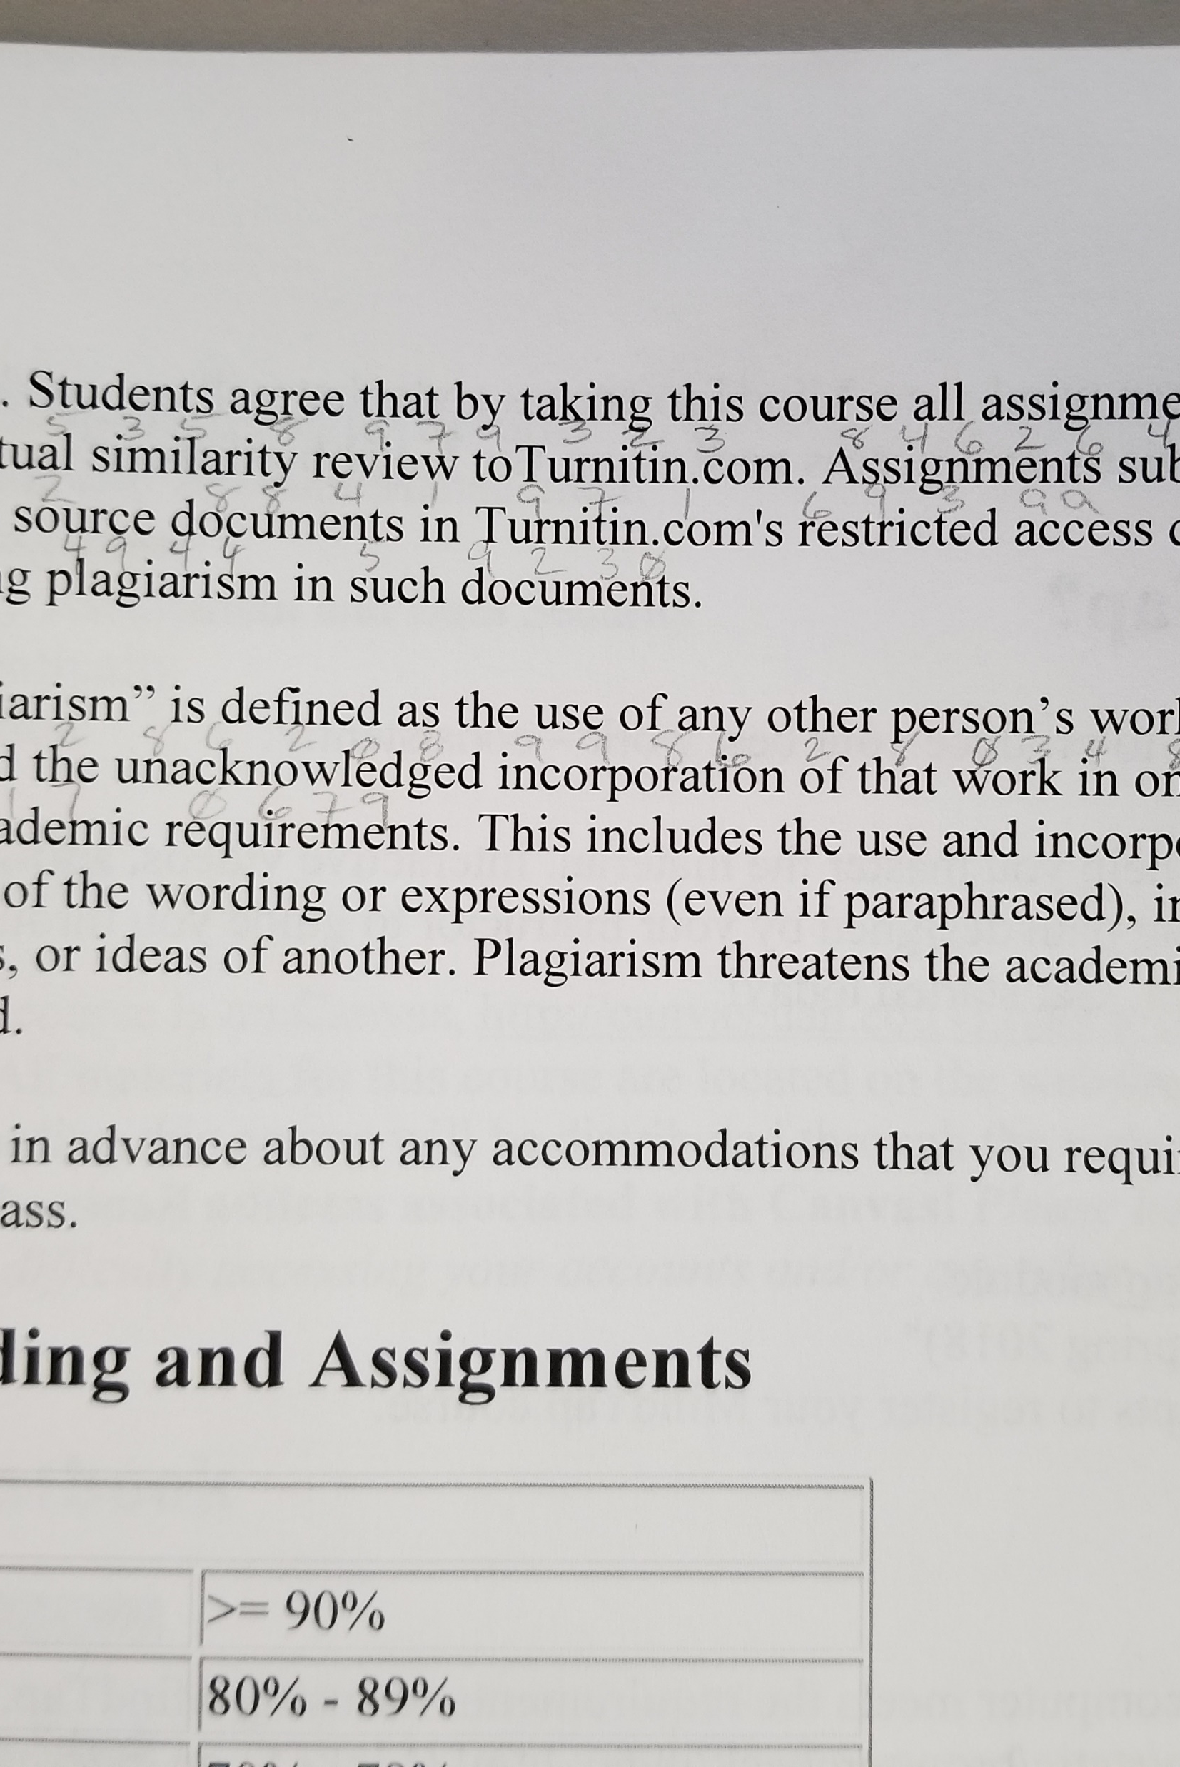
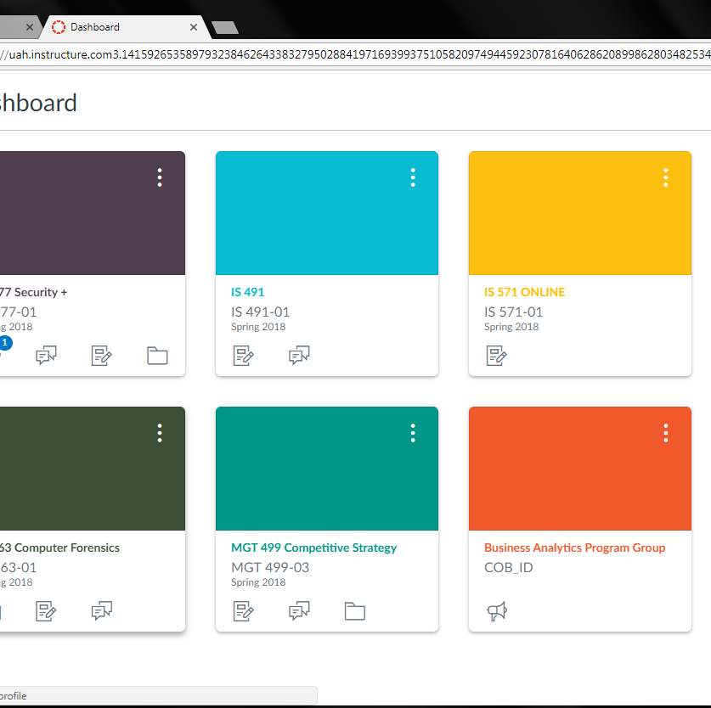

Slide 8
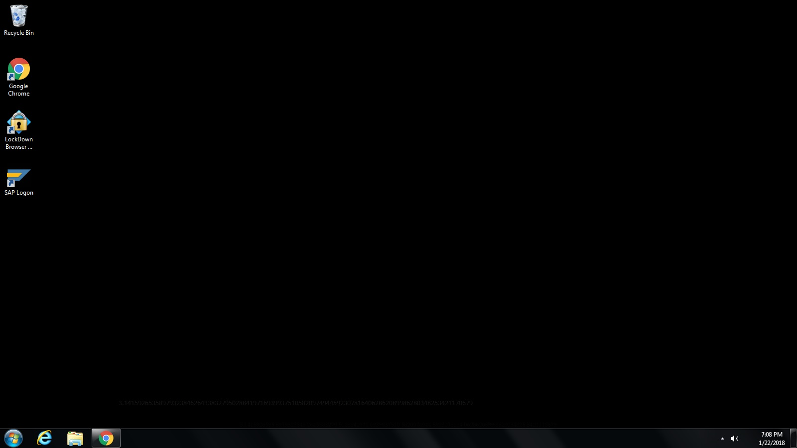
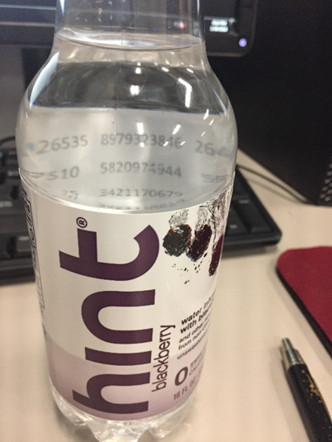
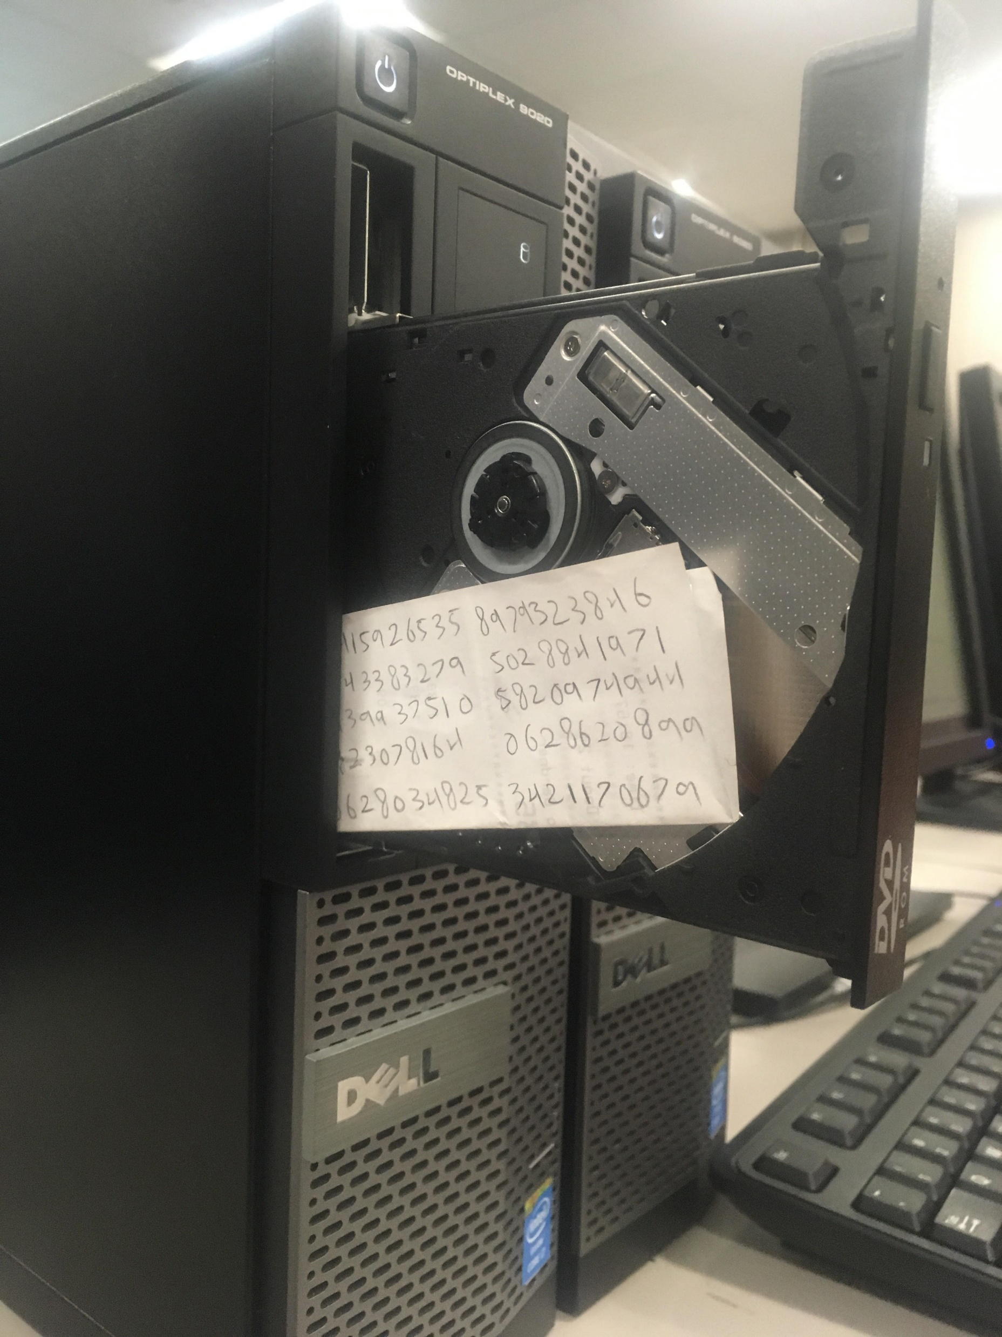
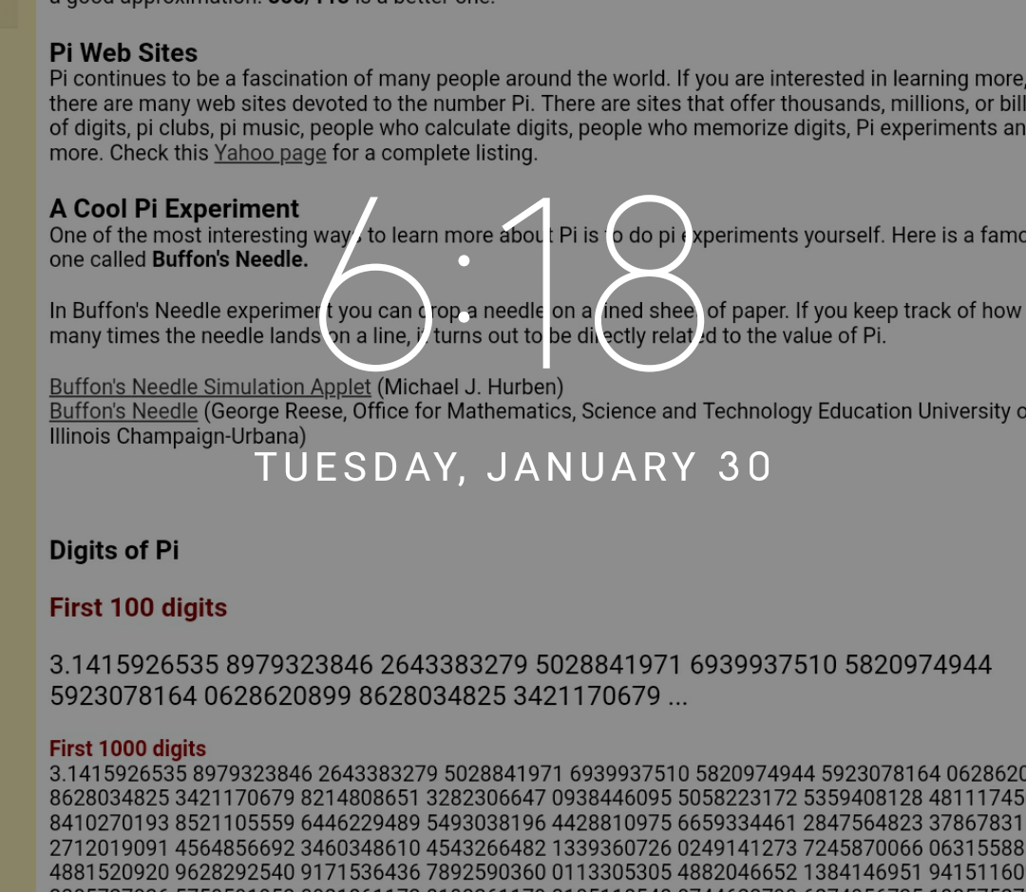

Slide 9
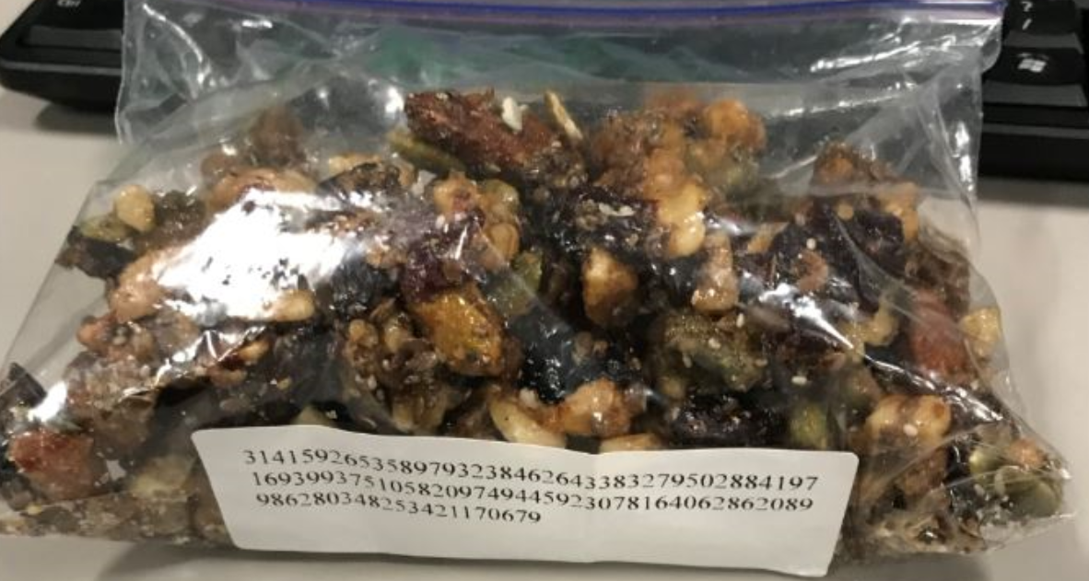
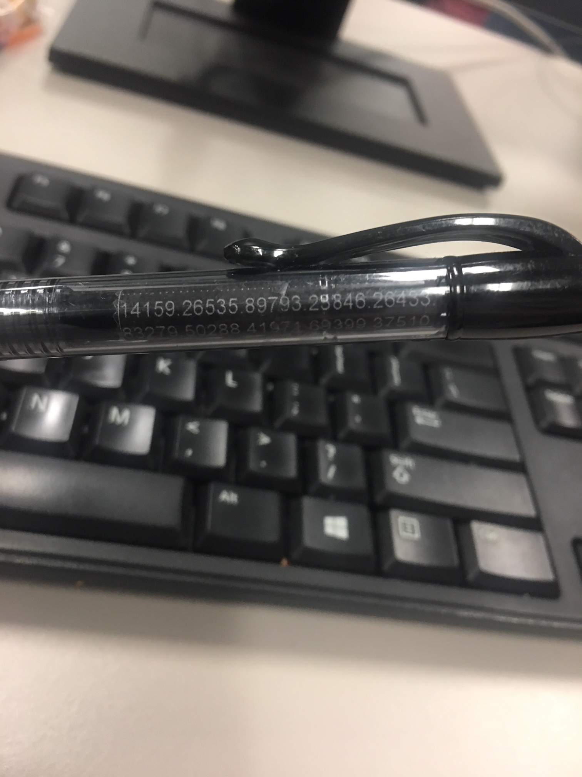
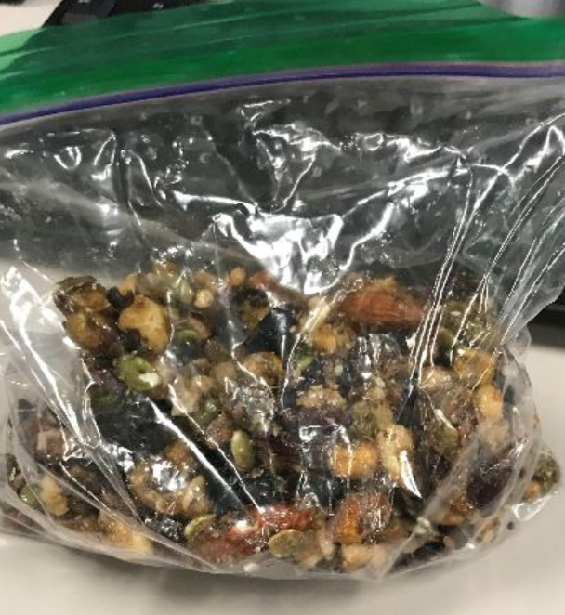
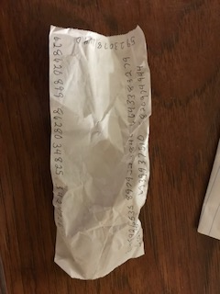

Slide 10
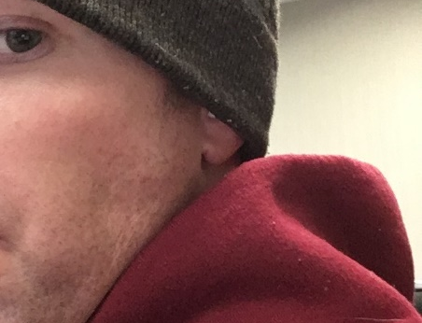
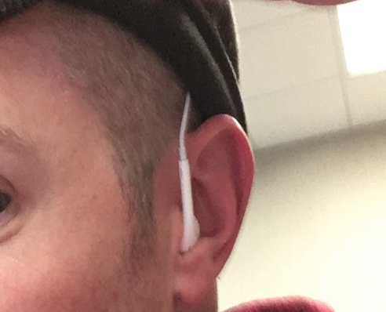
Audio Aided
Recorded playback via cell phone
Collusion with spouse via hidden headset

Slide 11
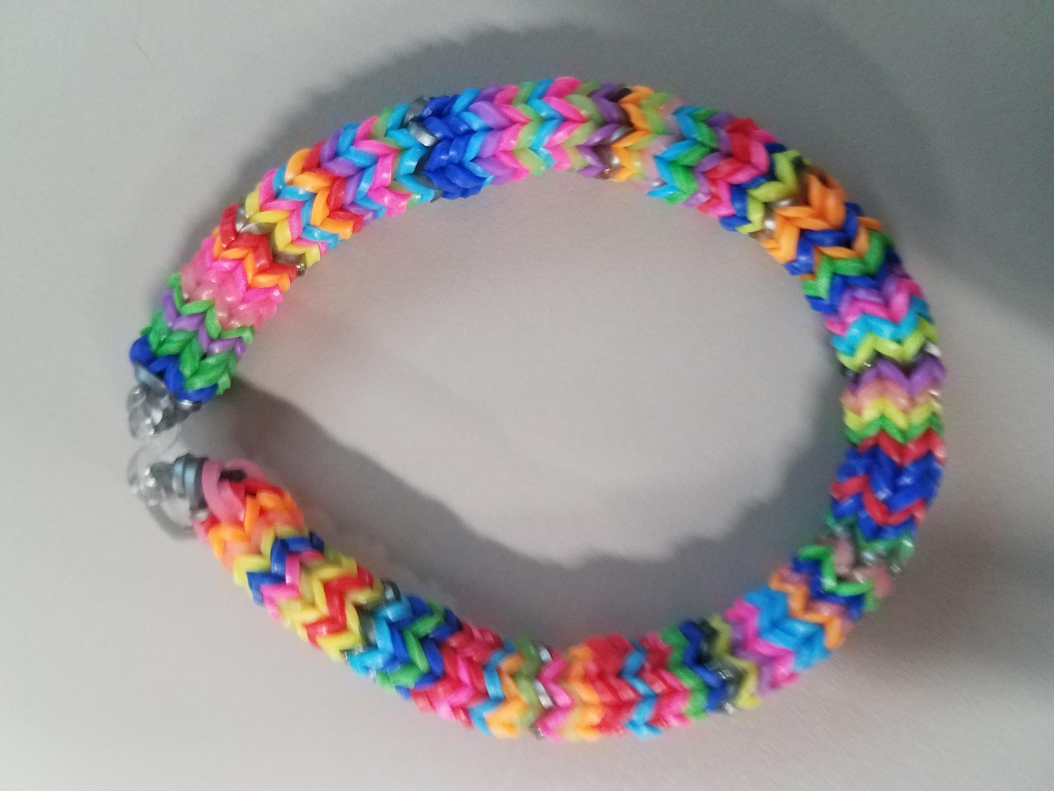
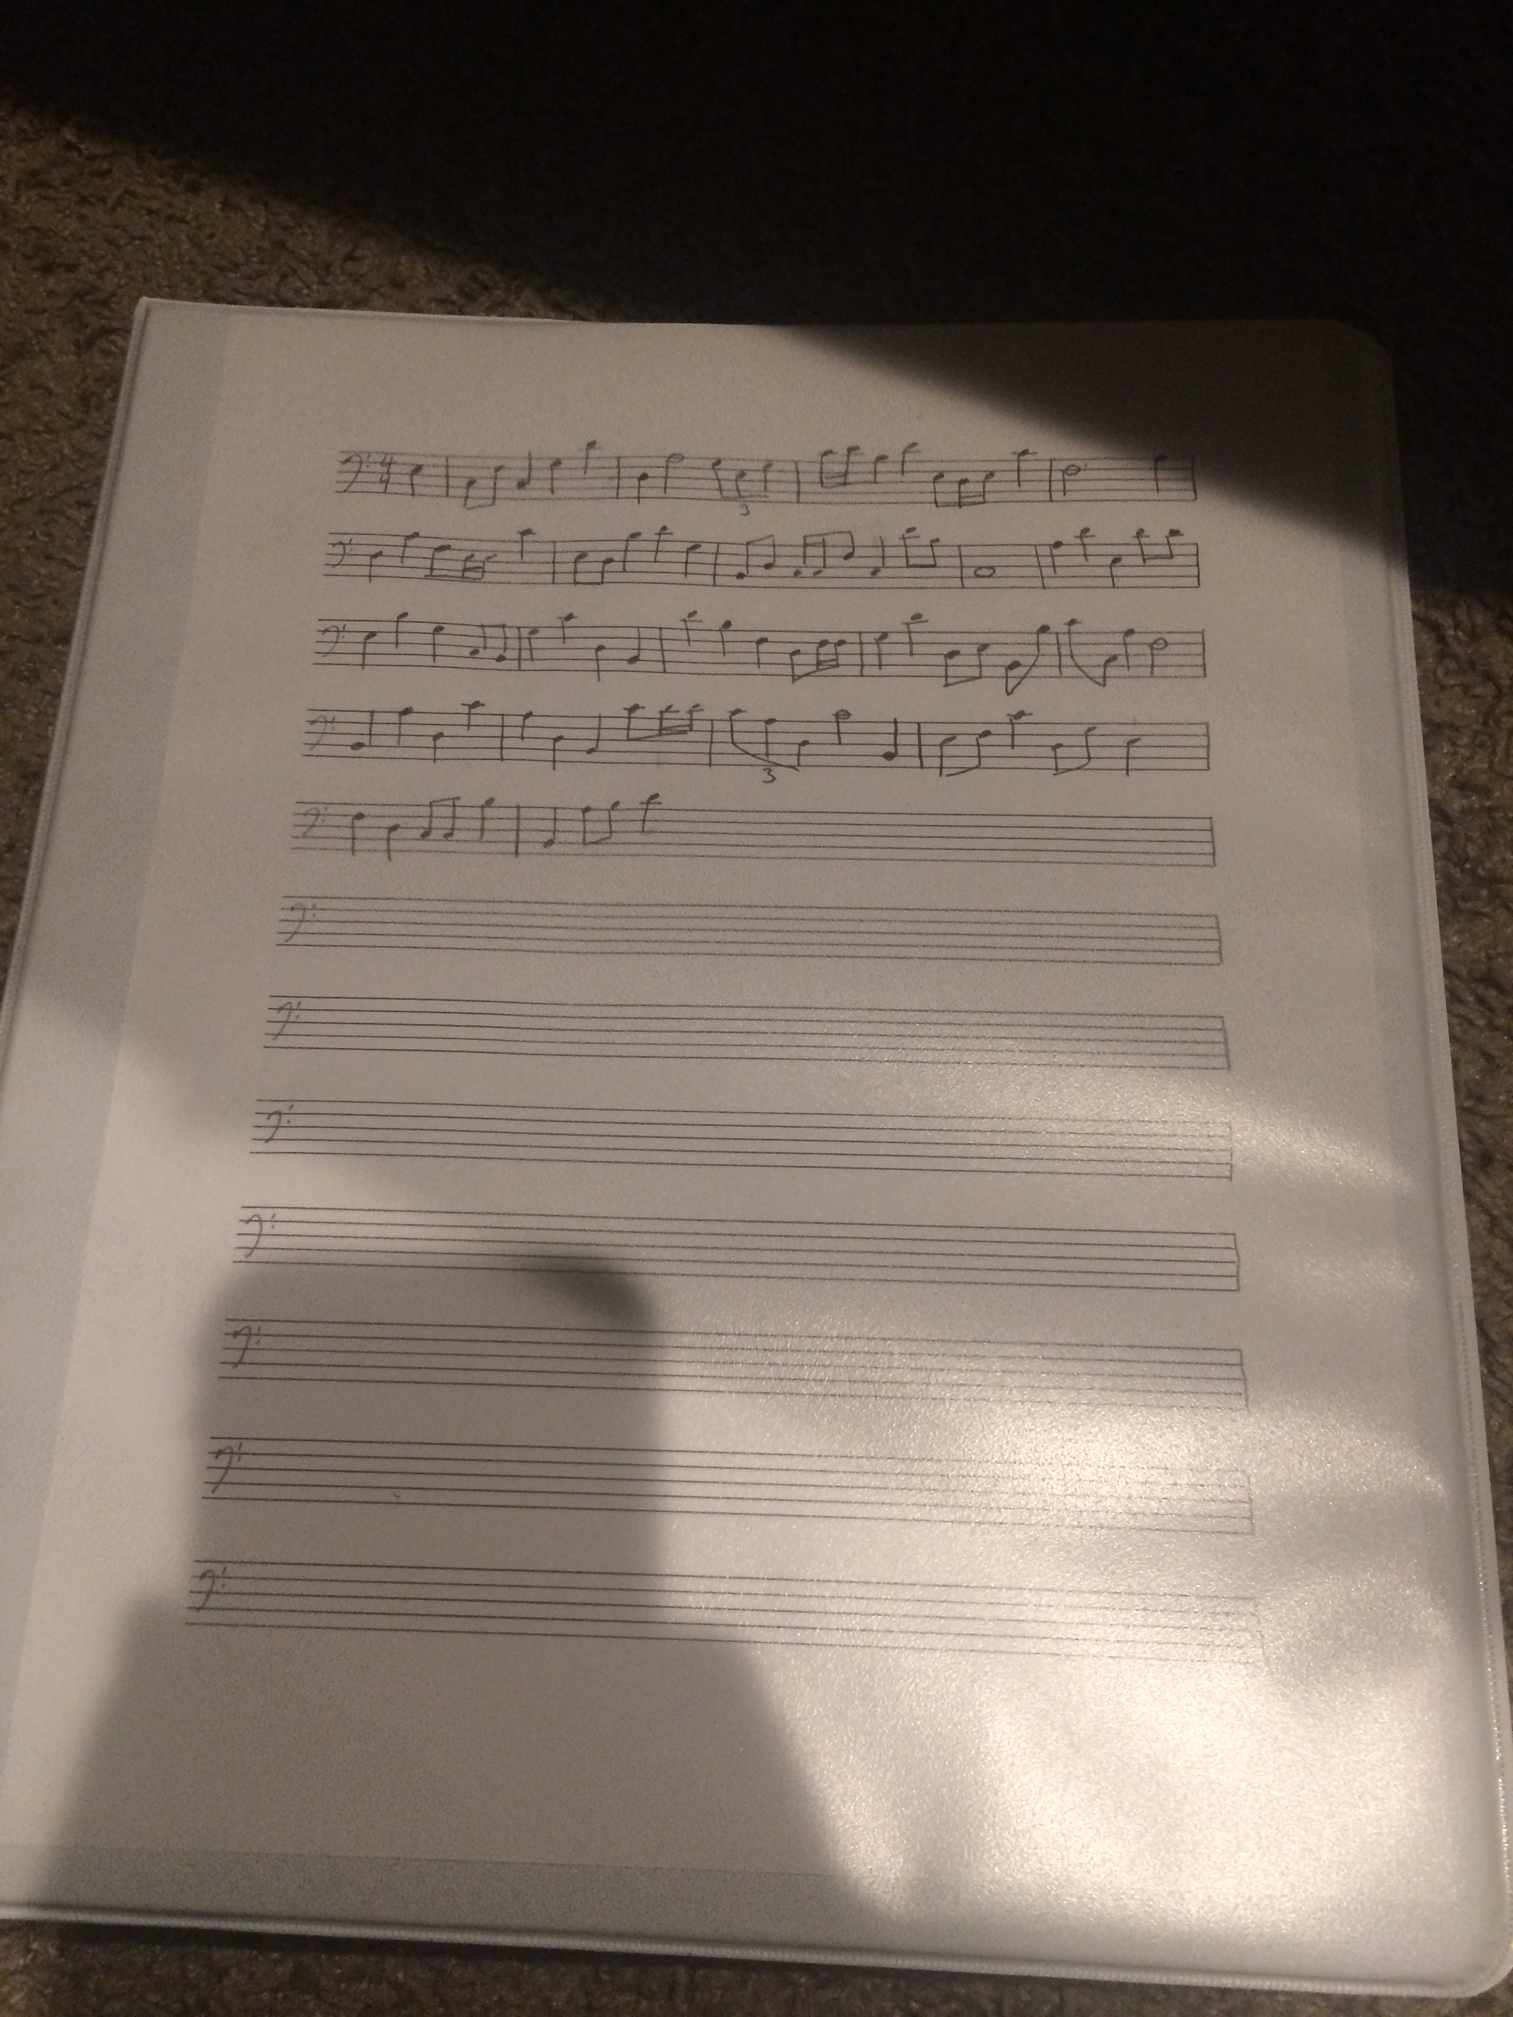
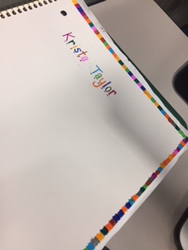
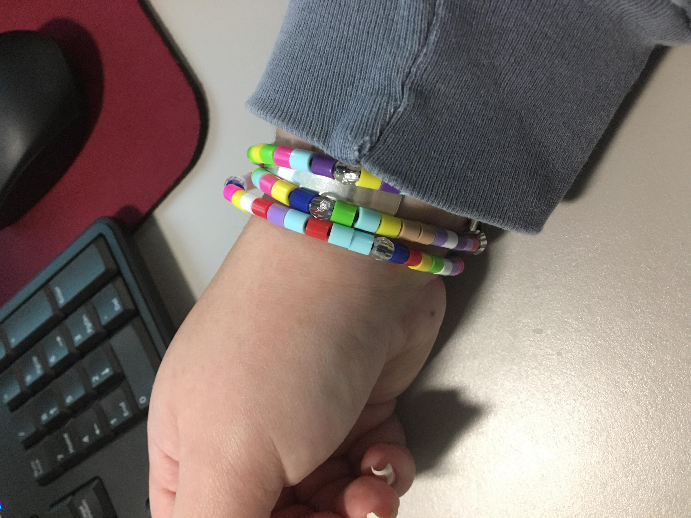
Cipher
Handmade bracelet
Sheet music
Wrote encoded python program hidden as a text and image file
Created a “Star Trek” looking cipher
Colored blocks along edge of paper

Slide 12
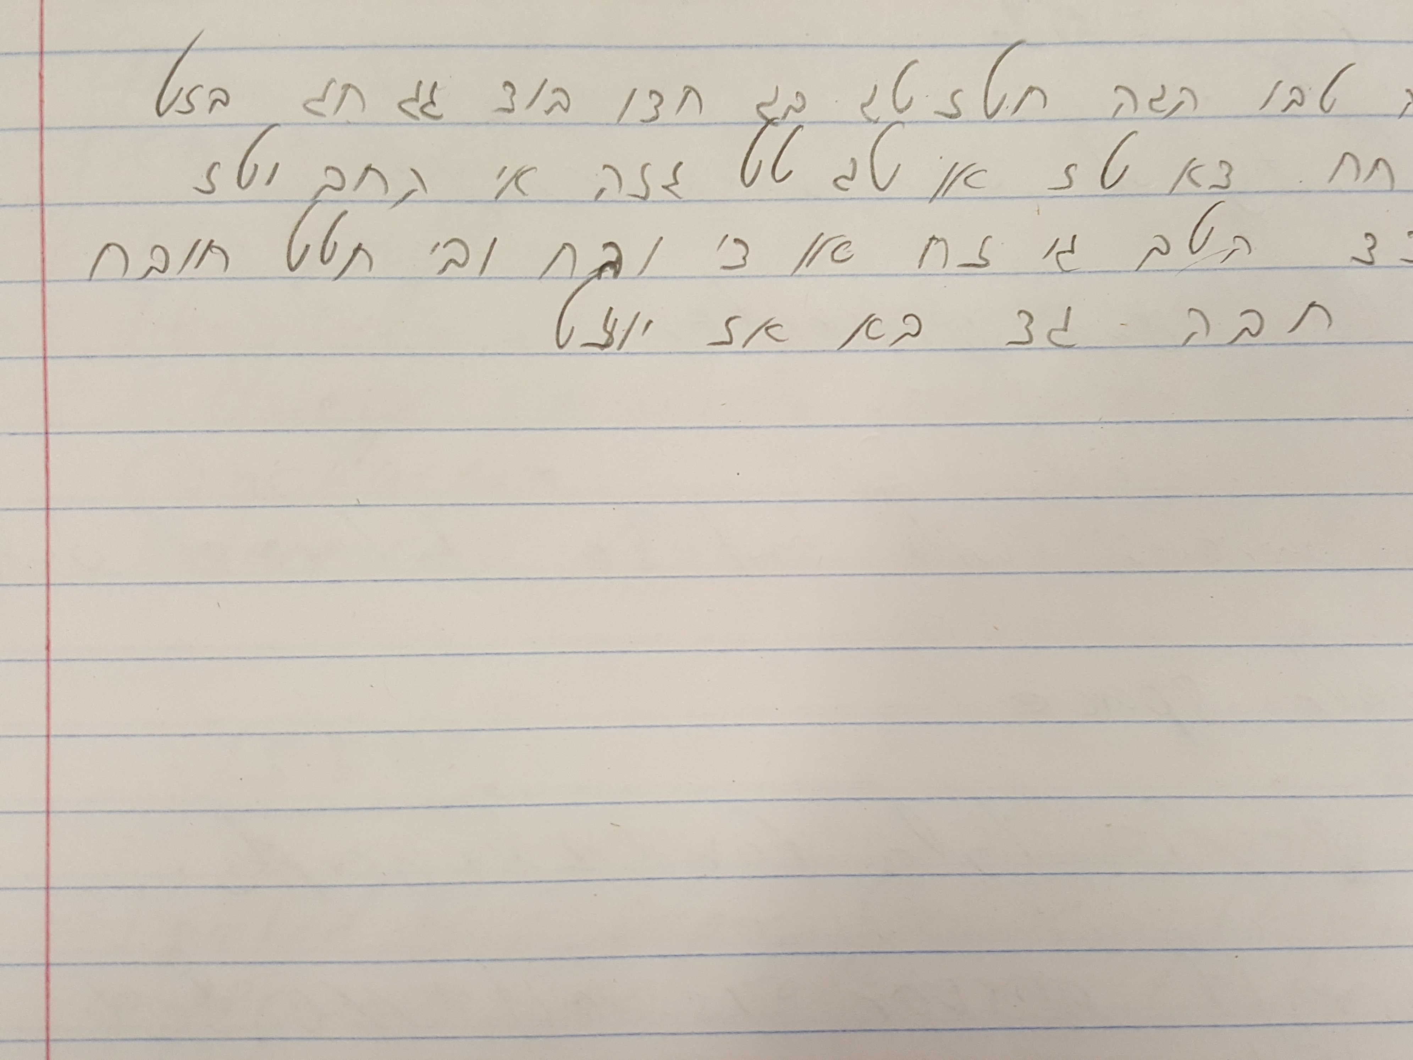
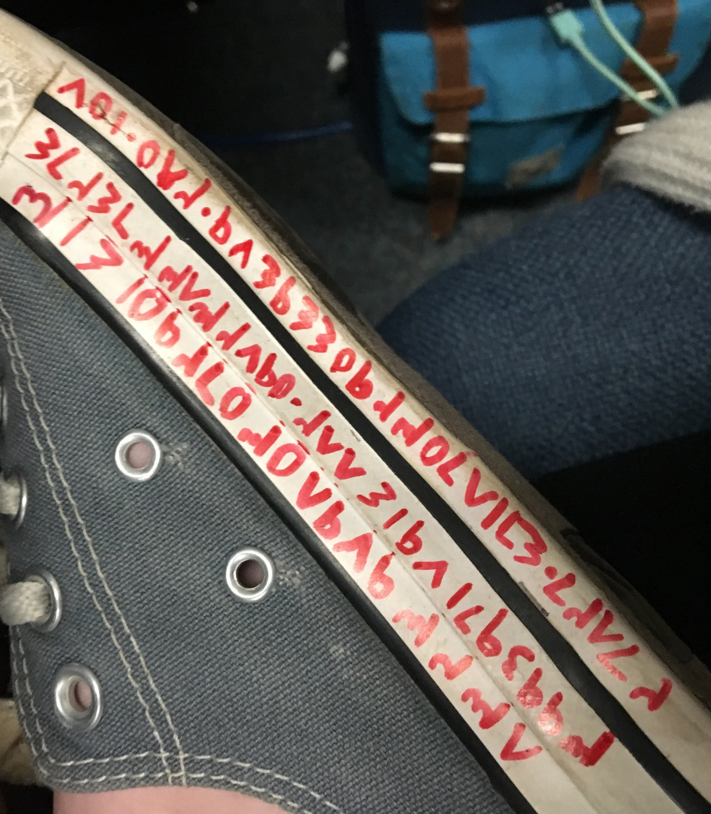
Foreign Language
Use a non-English representation of the digits of Pi
Arabic
Hebrew

Slide 13
Non-cheating
Memory recall
Grad student memorized first 17 digits, then use mnemonics to recall the rest
Partial memory recall
Memorized a partial sequence under the assumption the instructor would not verify the entire sequence.
This was a correct assumption.

Slide 14
Lazy A– Student
Wrote out the assignment before class and turned in
Wrote "the first 100 digits of the mathematical constant, π. Bring your own paper.“ Literally.

Slide 15
Results
 | Hidden Cleartext | Cipher | LAS | Audio | Foreign Language | Non-cheat
Grad | 17 | 3 | 4 | 2 | 3 | 2
 | 55% | 10% | 13% | 6% | 10% | 6%
Ugrad | 19 | 3 | 11 | 0 | 0 | 0
 | 58% | 9% | 33% | 0% | 0% | 0%
Total | 36 | 6 | 15 | 2 | 3 | 2
 | 56% | 9% | 23% | 3% | 5% | 3%

Slide 16
Thanks!
Questions?
ben@bendenton.com bdenton@dese.com dentonb@uah.edu

